Slide 1
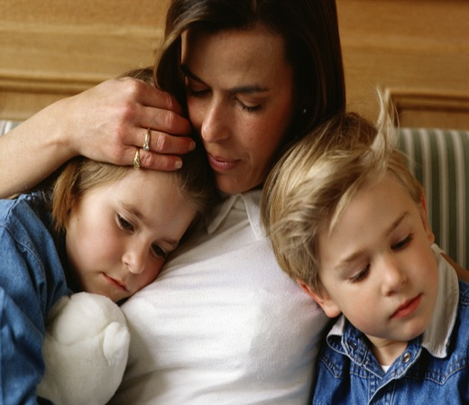
Not Now, Not Ever
Domestic and Family Violence Awareness
© PhotoAlto. Photographer: Michael Bussy³
Notes:
Purpose of this Presentation – to raise staff awareness of the issue of domestic and family violence, its impact and the supports available to DET staff.
This presentation has been developed for Central Office and Regional Office staff, with the view that Managers or Human Resources staff would be able to deliver this presentation to staff, using the facilitator notes provided for each slide. Please note, a different presentation has been developed for school based staff.
Facilitator notes:
It is important to be mindful that the information in this presentation may be of personal relevance to staff in the room.
Please ensure debriefing opportunities are available after the presentation, and on an ongoing basis including access to information about available support and services available.
For any queries please contact Christine Loos, Principal HR Consultant, Human Resources. Christine.loos@dete.qld.gov.au
Image: PHOTOGRAPHER OR SOURCE: Michael Bussy
COPYRIGHT: © PhotoAlto

Slide 2
What is domestic and family violence?
Domestic violence refers to interpersonal violence and abuse, which is aimed at controlling a partner through use of power and fear. It can exist within a range of intimate, or previously intimate, personal relationships.
Family Violence refers to violence and abuse between other immediate and extended family members and includes abuse between parents and children, elders, siblings and others.
Informal care relationships can also be considered violent or abusive if the carer uses their power to intimidate, control or abuse the person in their care.
EVERYONE, regardless of their age, socio-economic status, sexuality, gender, culture, race and geographical location can be affected.
Notes:
Facilitator Notes:
Domestic and family violence is usually characterised by instances or patterns of behaviours aimed at controlling a partner or family member through fear.
It is generally understood as gendered violence, in that it is mainly perpetrated against women and their children by men (DV Connect). While, most commonly, domestic violence is violence by a husband to his wife or a man to his female sexual partner or ex-partner, men do also experience domestic and family violence.
Domestic violence includes relationships between de-facto, married, previously married/separated, same-sex partners, engaged and couple relationships and between parents and former parents of a child.
Family violence can occur in extended families and even within family members not related by blood or marriage but where a mutual family obligation seems to fit.
Please note: The terms Domestic Violence and Family Violence can, at times, may be used interchangeably.
Informal care relationships (within Queensland legislation) refers to relationships where one person has taken on, in an unpaid, voluntary capacity, support for another person’s daily living requirements (including dressing, preparing meals, shopping etc.) In these instances, the carer uses their position of power to control, abuse and instil fear in the other person. Informal care relationships do not exist between a child and a parent of a child; or where there is a fee paid for care.
References:
Definitions provided above for ‘domestic violence’ and ‘family violence’ are paraphrased and have been taken from the White Ribbon Fact Sheet “Family and Domestic Violence”
http://www.whiteribbon.org.au/uploads/media/updated_factsheets_Nov_13/Factsheet_6_Family_and_domestic_violence.pdf
And from
DVConnect’s webiste page: What is domestic and family violence? http://www.dvconnect.org/education-resources/elder-abuse/

Slide 3
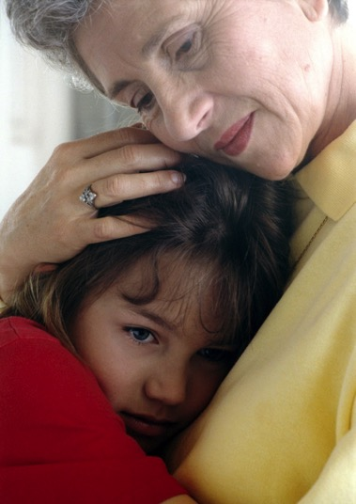
Domestic and family violence facts
1 in 6 Australian women have experienced physical abuse at the hands of a current or former partner
1 in 4 Australian women have experienced emotional abuse by a current or former partner
1 in 19 Australian men will experience physical or sexual violence from a partner or former partner
66 000 incidents of domestic and family violence were reported to Queensland police in the 2013/14 year
On average, across Australia, 1 woman is killed by her partner every week
© PhotoAlto. Photographer: Michael Bussy³
Domestic and Family Violence ruins lives
Notes:
Facilitator Notes: (Additional data and notes for discussion)
Australian police and court crime data indicate that women constitute a significant proportion of reported victims of intimate partner violence, while men make up a significant proportion of reported abusers. This data tends to focus on physical and sexual violence. Australian population survey data similarly show that women were more likely than men to be victims of physical, sexual and other forms of violence by a partner.
Ref: Meyering I & Braaf R 2013. Gender and intimate partner violence. Sydney: Australian Domestic and Family Violence Clearinghouse.
Women are over-represented in data relating to violence or abuse experienced at the hands of others. 1 in 3 Australian women will experience some form of violence in their lifetime.
Australian Bureau of Statistics (ABS), 2012.
The facts and statistics around Domestic and Family Violence in Australia can vary widely according to the definition of domestic and family violence, and statistics around the physical, emotional and financial impacts are sometimes equally hard to separate.
Between 80 and 100 Australian women die at the hands of their male partners every year – and a woman in Australia is more likely to be killed in her own home by her male partner than anywhere else or by anyone else.
ABS Personal Safety Survey, 2006.
References for statistics provided within slide
Australian Bureau of Statistics (ABS), 2012.
Australian Bureau of Statistics (ABS), 2012.
Our Watch – Violence against Women Key Statistics Fact Sheet – Fact sheet data sourced from ABS.
Not Now, Not Ever: Putting an End to Domestic and Family Violence in Queensland Taskforce Report, 2015.
Not Now, Not Ever: Putting an End to Domestic and Family Violence in Queensland Taskforce Report, 2015.
IMAGE: PHOTOGRAPHER OR SOURCE: Michael Bussy
COPYRIGHT: © PhotoAlto

Slide 4
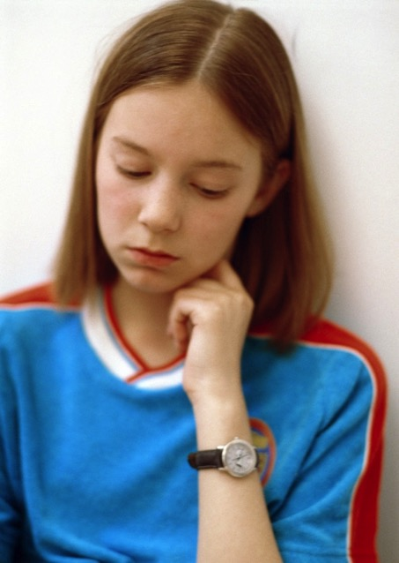
Domestic and family violence facts
61% of people had children in their care when the violence occurred, including 48% who stated the children had seen and heard the violence
Children are present in 1 in 3 domestic and family violence matters reported to police in Australia
Statistically, boys who witness domestic and family violence are twice as likely to abuse their own partners and children when they become adults
It’s estimated only 14-36% of those subjected to domestic and family violence report it to police
COPYRIGHT: © PhotoAlto Michael Bussy
Notes:
Facilitators Notes:
Suggested Activity (optional)
Ask the group for ideas about why they think women and children don’t always report or seek help following experiences of violence or abuse and discuss.
Some answers include – shame/embarrassment, fear of escalating the violence or abuse, fear of not being believed, concerns for safety of children or other family members, lack of financial independence, a perception that their matter is too trivial to report, have previously been turned away when seeking support.
While it may appear a private issue, domestic and family violence, is a community issue– It affects the physical health and emotional wellbeing, the learning capacity and productivity and ability to earn a living for thousands of men, women and children across Queensland every day.
References for statistics provided within slide
Australian Bureau of Statistics (ABS), 2012.
2, 3, 4. Family Violence piktograph published on Artsonline Monash University, Melbourne Tribune article entitled “$85 Million injected into family violence and ice research” 16 April 2015 Source: Crime Statistics Victoria, Domestic Violence Victoria, Australian Domestic and Family Violence Clearinghouse.
PHOTOGRAPHER / SOURCE: Michael Bussy
CAPTION / DESCRIPTION: © PhotoAlto. Photographer: Michael Bussy
COPYRIGHT: © PhotoAlto

Slide 5
Forms of domestic and family violence
Sexual
Physical
Verbal
Emotional/
psychological
Power & Control
Financial
Stalking
Damage to personal property
Social & Spiritual
Notes:
Facilitator Notes:
Detailed notes for each form of domestic and/or family violence is provided below:
Suggested Activity (optional)
If appropriate to group comfort levels, ask for examples of the types of abuse and violence that might be experienced in the above domains. The facilitator may choose instead to provide some examples themselves from the list below. It is important to be mindful that the information in this presentation may be of personal relevance to staff in the room.
Forms of Domestic and Family Violence
Domestic and family violence takes many different forms but always involves one person using their power and fear to control and intimidate the other person
Domestic and family violence is often hidden. Many forms of this violence and abuse are not easily observed by friends, family and colleagues
Domestic and family violence can take many forms, including intimidation, coercion, isolation, emotional, physical, sexual, financial and spiritual abuse. The impacts upon individuals, children, families and the wider community are significant. Domestic and family violence can include a wide range of behaviours.
Physical abuse - including direct assaults on the body, use of weapons, driving dangerously, destruction of property, abuse of pets in front of family members, assault of children, denial of needed medical care, locking the victim out of the house, and sleep deprivation.
Sexual abuse - Sexual abuse and assault (or sexual violence) is any unwanted sexual behaviour towards another person which occurs without the person’s informed consent. Sexual abuse includes intimate partner sexual violence, which can include coercion into sexual intimacy, often using a range of threats to control and instil fear, including threats of physical violence. Sexual violence includes rape, date rape, incest and a range of other acts of sexual violence. All acts of sexual violence are serious crimes.
Verbal abuse – includes continually using ‘put downs’ and behaviours and words intended to humiliate, either privately or publicly, with attacks following clear themes that focus on intelligence, sexuality, body image and capacity as a parent and spouse or partner.
Emotional/Psychological abuse – includes blaming the partner or family member for all problems in the relationship, constantly comparing that person with others to undermine their self-esteem and self-worth, sporadic sulking, withdrawing all interest and engagement (e.g. weeks of silence) to assert control and elicit fear.
Social abuse – involves systematic isolation from family and friends through techniques such as ongoing rudeness to family and friends, moving to locations where the partner knows nobody, and forbidding or physically preventing the victim from going out and meeting people.
Financial abuse – involves control of money and finances, including refusing access to money and withholding access to bank accounts, providing only an inadequate ‘allowance’, controlling or using all wages earned or legally owed to the other person, through welfare entitlements for their own purpose, or by preventing their partner from seeking or holding down a job.
Damage to personal property - Using physical strength or violence to intimidate you by causing or threatening to cause damage to your property or valuables, e.g. kicking walls, throwing things, pulling a door off hinges or damaging your furniture, car or personal belongings.
Spiritual/Cultural Abuse - Not allowing a person in a relationship the freedom to practise their chosen religion or cultural beliefs, or misusing religious or spiritual traditions to justify physical or other abuse towards a person.
Stalking - Constantly worrying or frightening a partner by following them, watching them, phoning or messaging them and waiting outside the home or their workplace.
Reference for content within notes and slide:
Information collated from: Department of Communities, Child Safety and Disability Services Trust Your Instinct campaign; DVConnect; National Council of Single Mothers and their Children; NOT NOW, NOT EVER: Putting an End to Domestic and Family Violence in Queensland Taskforce Report, 2015; Our Watch; White Ribbon.

Slide 6
Signs of domestic and family violence
People experiencing domestic or family violence may:
seem afraid of their partner or someone else close to them
seem anxious, depressed, unusually quiet or less confident
have a partner who is controlling, obsessive or jealous
have a partner who has threatened to harm them, their children or pets
have a partner who is depressed or suicidal
stop contact with friends and family for no good reason
know or suspect they are being stalked or receive constant texts or phone calls from their partner
appear neglected or unable to access their money or belongings
Notes:
Facilitator Notes:
A person may be in greater danger if:
There is a history of domestic and family violence
Violence, including sexual violence, has escalated within the relationship
Their partner is stalking or monitoring their movements
They separate or plan to separate from their partner without a safety plan in place
They start a new relationship or their ex-partner believes they have
There is conflict within the broader family
There are issues about child custody or access to children
They are pregnant
There is financial hardship or the partner becomes unemployed
The partner has a history of physical violence, mental illness or access to weapons.
Reference for slide and notes content:
Department of Communities, Child Safety and Disability Services Trust Your Instinct campaign https://www.communities.qld.gov.au/communityservices/violence-prevention/trust-your-instinct/domestic-and-family-violence/helping-others/signs-of-domestic-and-family-violence

Slide 7

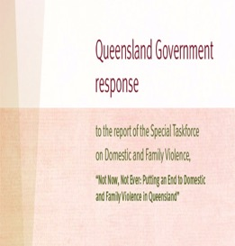

What can be done about domestic and family violence?
September 2014 - Taskforce on Domestic and Family Violence in Queensland, chaired by the Honourable Quentin Bryce AD CVO, former Governor-General of Australia, was established
February 2015 – the ‘Not Now, Not Ever’ Taskforce Report was released
August 2015, the Queensland Government responded to this report accepting all 140 recommendations
A draft Domestic and Family Violence Prevention Strategy was developed to provide a high level plan to eliminate domestic and family violence in Queensland over the next 10 years
The Department of Education and Training has a leadership responsibility for implementing 9 of the 140 Taskforce recommendations.
Notes:
10 September 2014 - Taskforce on Domestic and Family Violence in Queensland, chaired by the Honourable Quentin Bryce AD CVO, former Governor-General of Australia, was established
Feb 15 - Not Now, Not Ever: Putting an End to Domestic and Family Violence in Queensland’ Taskforce Report was handed to the Premier by Chair, Dame Quentin Bryce.
Aug 15 – 121 recommendations accepted as Government responsibility; the remaining 19 applied to the Non-Government sector and were fully supported by the Government.
Aug 15 – The draft Domestic and Family Violence Prevention Strategy was developed to provide a high level plan to eliminate domestic and family violence in Queensland over the next 10 years.
Leadership recommendations for DET include raising awareness of all staff to recognise and respond to domestic and family violence to helping to change attitudes and behaviours of students towards violence and abuse in relationships, through curriculum and whole of school measures.

Slide 8

No More: DFV awareness raising ad, aired during the 2015 Super Bowl
A true story re-enacted
Notes:
Click on the video to make it play.
Watch the official Super Bowl NO MORE ad (the first-ever Super Bowl commercial addressing domestic violence and sexual assault). The ad aired live during the Super Bowl on February 1, 2015.
The 911 call is a re-enactment based on this true story, and inspired by other women using the tactic of disguising their calls while reaching out for help.

Slide 9
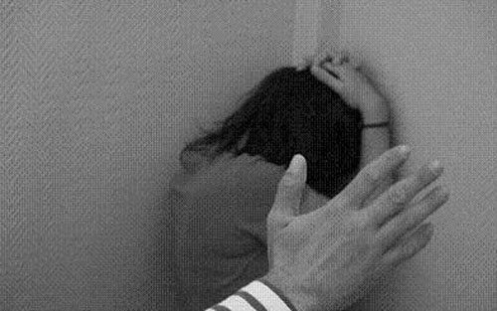
Why is domestic and family violence a workplace issue?
Of those women who experience domestic violence and abuse, two-thirds are employed
1 in 5 say the violence follows them to work through:
  phone calls
  emails
  texts
  and the person who used violence or abuse presenting in the workplace.
  DET is committed to assisting its staff affected by domestic and family violence. A culture where staff personally affected feel able to seek assistance is vital.
  Raising awareness of the signs and indicators of domestic and family violence is a key strategy for supporting staff affected
  In consultation with the employee, managers have a responsibility to put in place measures to increase the safety of the staff member affected and others
  Domestic and family violence is estimated to cost the Queensland economy between $2.7 and $3.2 billion annually.
  The cost to Australian employers is estimated to be $175 million annually.
Notes:
Facilitator Notes:
Suggested Activity
Discuss as a group how domestic and family violence might impact upon an employee and the workplace.
Workplace impacts include:
Increased employee absence/leave (increase in sick leave, emergent leave or other forms of leave)
Coming to work late or staying at work longer hours to avoid going home
Time off for illness/injury
Reduced performance at work (decreased concentration, decreased quality and productivity at work)
Presenteeisn – attending work but not working as effectively as needed
Disruption to the workplace for the employee, their colleague and others
Possible loss of job where circumstances aren’t known and the staff member is unaware of the support available to them
Reference for slide and notes content:
Content for slide and notes taken from CEO Challenges’ Recognise Respond Refer’ online modules
Reference for slide and notes content:
Content for slide and notes taken from CEO Challenges’ Recognise Respond Refer’ online modules
Data about costs of domestic and family violence taken from the Queensland draft Domestic and Family Violence Prevention Strategy 2015-2025
Image:
Concha Garcia Hernandez, Violencia de genero, https://commons.wikimedia.org/wiki/File:20081123120727-violencia-de-genero.jpg
CC-BY-SA

Slide 10


What is DET doing to support staff experiencing domestic and family violence?
DET has signed up with Australia's CEO Challenge for a two year Workplace Domestic / Family Violence Prevention Program.
DET has published a declaration for all staff that confirms domestic and family violence is:
  Never acceptable
  Everyone has the right to feel safe and supported
  Everyone has a responsibility to act
DET is in the process of finalising a ‘Domestic and Family Violence’ policy and a series of fact sheets to supports staff and managers on this issue
CEO Challenge’s online learning modules, ‘Recognise, Respond and Refer will soon be available to all staff.
Notes:
Facilitator Notes:
CEO Challenge Program: - DET will soon be making available to all staff, CEO Challenge’s ‘Recognise, Respond, Refer’ online training modules. These will be available on the Learning Place and provide an excellent overview of the indicators and impacts of domestic violence, particularly as it affects the workplace.
DET also plans to offer training for Managers and Principals to assist them in responding appropriately to instances of domestic and family violence
Once finalised, DET’s Domestic and Family Violence policy and fact sheets will be promoted to all staff, to help raise awareness of the Department’s position in relation to domestic and family violence and of the support DET provides to staff affected

Slide 11

Practical support for staff affected by domestic and family violence may include
Special leave for emergent domestic and family violence issues
Workplace safety plans to help increase the safety of the affected staff member and others in the workplace
Flexible working conditions, if feasible – e.g. different start and finish times, altered work timetable
Support to return to work, if required
Temporary or permanent relocation where required
Access to confidential counselling
Notes:
Facilitator Notes:
Discretionary Paid Special Leave entitlements are outlined within the Special Leave Directive 9/13. Principals and Managers can approve up to 5 days. For discretionary special leave greater than 5 days, Regional Directors, Assistant Regional Directors and the Assistant Director General HR can consider and approve paid leave on a case by case basis. Documentation to support this leave request is desirable. If however documentation is not able to be provided to support the request, consideration and approval can be provided to all requests.
Workplace Safety Plans are similar to a Rehabilitation and Return to Work Plan.
Have a start, review/end date and is developed by the Principal/Supervisor and affected staff member collaboratively.
Addresses issues such as:
identifying a safe place
identifying a co-worker
strategies for traveling to and from work
changes to working times
changes to work practices.

Slide 12

Support for Managers and Colleagues
If you are concerned about a colleague, let them know your concerns privately and encourage them to speak to their Supervisor/Manager
Encourage the person to contact a specialist domestic and family violence service for confidential information and support
DVConnect have a
24/7 Womensline (Ph: 1800 811 811)
Sexual Assault Helpline (Ph: 1800 010 120) 7.30am-11.30pm, 7 days)
Mensline (Ph: 1800 600 636) 9am-midnight, 7 days)
Notes:
Facilitator Notes: - Support for DET staff
If there are immediate safety concerns, the affected person should be encouraged to call the police for support and advice on ‘000’ (triple zero).
Counselling - Optum, is the Department’s external employee assistance service provider and they provide free, confidential counselling to staff and their immediate family members.
Staff are able to call to book either a face to face or telephone counselling appointment by telephoning: Optum directly on Ph: 1800 604 640
Advice on leave, transfer, relocation, rehabilitation and other workplace supports is available from HR officers located within regions and central office.
Specialist external information and advice for matters related to domestic and family violence.
For specialist advice related to domestic and family violence, all staff are encouraged to contact DVConnect.
DVConnect offers specialist emergency, support services and assistance for those in crisis, including referral to accommodation and access to transport.
They also offer specialist counselling and advice services for women and men impacted by domestic and family violence and for those impacted by sexual assault or violence

Slide 13
Questions

