Slide 1
Domestic and Family Violence Awareness
Notes:
Presentation for Principals to deliver to their staff in schools.
It is important to be mindful that the information in this presentation may be of personal relevance to staff in the room.
Please ensure debriefing opportunities are available after the presentation, and on an ongoing basis, including access to information about available support and services available.

Slide 2
What is domestic and family violence?
Domestic violence refers to interpersonal violence and abuse, aimed at controlling a partner through use of power and fear. It can exist within a range of intimate, or previously intimate, personal relationships.
Family Violence refers to violence and abuse between other immediate and extended family members and includes abuse between parents and children, elders, siblings and others.
Notes:
Domestic and family violence is usually characterised by instances or patterns of behaviours aimed at controlling a partner or family member through fear.
It is generally understood as gendered violence, in that it is mainly perpetrated against women and their children by men (DV Connect). While, most commonly, domestic violence is violence by a husband to his wife or a man to his female sexual partner or ex-partner, men do also experience domestic and family violence.
Domestic violence includes relationships between de-facto, married, previously married/separated, same-sex partners, engaged and couple relationships and between parents and former parents of a child.
Family violence can occur in extended families and even within family members not related by blood or marriage but where a mutual family obligation seems to fit.
Please note: The terms Domestic Violence and Family Violence can, at times, be used interchangeably.
Flood M & Fergus L 2008. An assault on our future: The impact of violence on young people and their relationships. Sydney: White Ribbon Foundation. < http://www.whiteribbon.org.au/uploads/media/AssaultonourFutureFinal.pdf and DV Connect.
Vic Health,(2003) Public Health, Mental Health & Violence against Women.

Slide 3
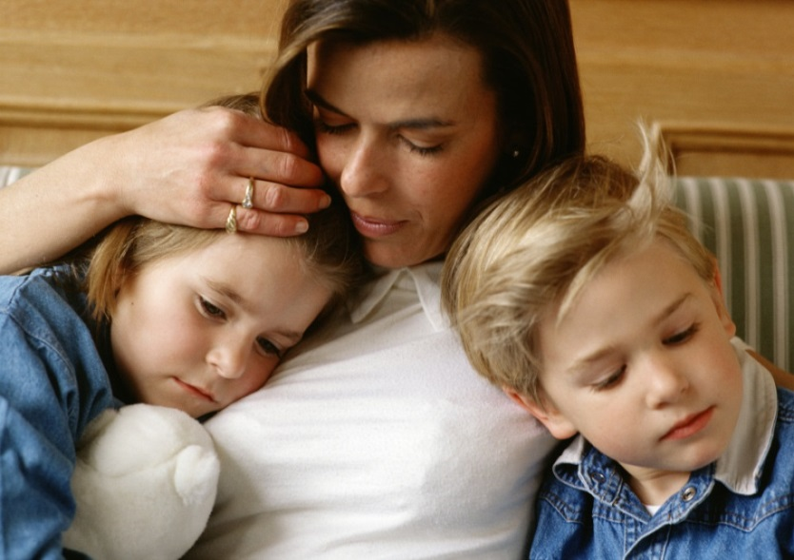
What is domestic and family violence?
Informal care relationships can also be considered violent or abusive if the carer uses their power to intimidate, control or abuse the person in their care.
EVERYONE, regardless of their age, socio-economic status, sexuality, gender, culture, race and geographical location can be affected.
© PhotoAlto. Photographer: Michael Bussy³
Notes:
Informal care relationships (within Queensland legislation) refers to relationships where one person has taken on, in an unpaid, voluntary capacity, support for another person’s daily living requirements (including dressing, preparing meals, shopping etc.) In these instances, the carer uses their position of power to control, abuse and instil fear in the other person. Informal care relationships do not exist between a child and a parent of a child; or where there is a fee paid for care.
Flood M & Fergus L 2008. An assault on our future: The impact of violence on young people and their relationships. Sydney: White Ribbon Foundation. < http://www.whiteribbon.org.au/uploads/media/AssaultonourFutureFinal.pdf and DV Connect.
Vic Health,(2003) Public Health, Mental Health & Violence against Women.
Image
PHOTOGRAPHER OR SOURCE: Michael Bussy
CAPTION / DESCRIPTION: © PhotoAlto. Photographer: Michael Bussy
COPYRIGHT: © PhotoAlto

Slide 4
Forms of domestic and family violence
Verbal
Psychological
Sexual
Financial
Physical
Power and Control
Spiritual
Emotional
Social
Damage to property
Stalking
Notes:
Highlight to the audience that:
Domestic and family violence takes many different forms but always involves one person using their power and fear to control and intimidate the other person
Domestic and family violence is often hidden. Many forms of this violence and abuse are not easily observed by friends, family and colleagues
Optional activity
If appropriate to group comfort levels, ask for examples of the types of abuse and violence that might be experienced in the above domains. Principal may choose instead to provide some examples themselves from the list below. It is important to be mindful that the information in this presentation may be of personal relevance to staff in the room.
Information collated from: Department of Communities, Child Safety and Disability Services Trust Your Instinct campaign; DVConnect; National Council of Single Mothers and their Children; NOT NOW, NOT EVER: Putting an End to Domestic and Family Violence in Queensland Taskforce Report, 2015; Our Watch; White Ribbon.
Forms of Domestic and Family Violence
Domestic and family violence can take many forms, including intimidation, coercion, isolation, emotional, physical, sexual, financial and spiritual abuse. The impacts upon individuals, children, families and the wider community are significant. Domestic and family violence can include a wide range of behaviours.
Physical abuse - including direct assaults on the body, use of weapons, driving dangerously, destruction of property, abuse of pets in front of family members, assault of children, denial of needed medical care, locking the victim out of the house, and sleep deprivation.
Sexual abuse - Sexual abuse and assault (or sexual violence) is any unwanted sexual behaviour towards another person which occurs without the person’s informed consent. Sexual abuse includes intimate partner sexual violence, which can include coercion into sexual intimacy, often using a range of threats to control and instil fear, including threats of physical violence. Sexual violence includes rape, date rape, incest and a range of other acts of sexual violence. All acts of sexual violence are serious crimes.
Verbal abuse – includes continually using ‘put downs’ and behaviours and words intended to humiliate, either privately or publicly, with attacks following clear themes that focus on intelligence, sexuality, body image and capacity as a parent and spouse or partner.
Emotional/Psychological abuse – includes blaming the partner or family member for all problems in the relationship, constantly comparing that person with others to undermine their self-esteem and self-worth, sporadic sulking, withdrawing all interest and engagement (e.g. weeks of silence) to assert control and elicit fear.
Social abuse – involves systematic isolation from family and friends through techniques such as ongoing rudeness to family and friends, moving to locations where the partner knows nobody, and forbidding or physically preventing the victim from going out and meeting people.
Financial abuse – involves control of money and finances, including refusing access to money and withholding access to bank accounts, providing only an inadequate ‘allowance’, controlling or using all wages earned or legally owed to the other person, through welfare entitlements for their own purpose, or by preventing their partner from seeking or holding down a job.
Damage to personal property - Using physical strength or violence to intimidate you by causing or threatening to cause damage to your property or valuables, e.g. kicking walls, throwing things, pulling a door off hinges or damaging your furniture, car or personal belongings.
Spiritual/Cultural Abuse - Not allowing a person in a relationship the freedom to practise their chosen religion or cultural beliefs, or misusing religious or spiritual traditions to justify physical or other abuse towards a person.
Stalking - Constantly worrying or frightening a partner by following them, watching them, phoning or messaging them and waiting outside the home or their workplace.

Slide 5
The Statistics
1 in 6 Australian women have experienced physical or sexual violence from a current or former partner
1 in 4 Australian women have experienced emotional abuse by a current or former partner
1 in 19 Australian men will experience physical or sexual violence from a partner or former partner
66 000 incidents of domestic and family violence were reported to Qld police in the 2013/14 year – more than 180 a day
1 woman is killed by her partner every week on average in Australia
Notes:
Australian police and court crime data indicate that women constitute a significant proportion of reported victims of intimate partner violence, while men make up a significant proportion of reported abusers. These data tend to focus on physical and sexual violence. Australian population survey data similarly show that women were more likely than men to be victims of physical, sexual and other forms of violence by a partner.
Meyering I & Braaf R 2013. Gender and intimate partner violence. Sydney: Australian Domestic and Family Violence Clearinghouse.
Women are over-represented in the data relating to those who have experienced violence or abuse at the hands of others. 1 in 3 Australian women will experience some form of violence in their lifetime. (Australian Bureau of Statistics, 2012.)
The facts and statistics around Domestic and Family Violence in Australia can vary widely according to the definition of domestic and family violence, and statistics around the physical, emotional and financial impacts are sometimes equally hard to separate.
Between 80 and 100 Australian women die at the hands of their male partners every year – and a woman in Australia is more likely to be killed in her own home by her male partner than anywhere else or by anyone else.
ABS Personal Safety Survey, 2006.
Australian Bureau of Statistics (ABS), 2012.
Australian Bureau of Statistics (ABS), 2012.
Our Watch – Violence against Women Key Statistics Fact Sheet – Fact sheet data sourced from ABS.
Not Now, Not Ever: Putting an End to Domestic and Family Violence in Queensland Taskforce Report, 2015.
Not Now, Not Ever: Putting an End to Domestic and Family Violence in Queensland Taskforce Report, 2015.

Slide 6
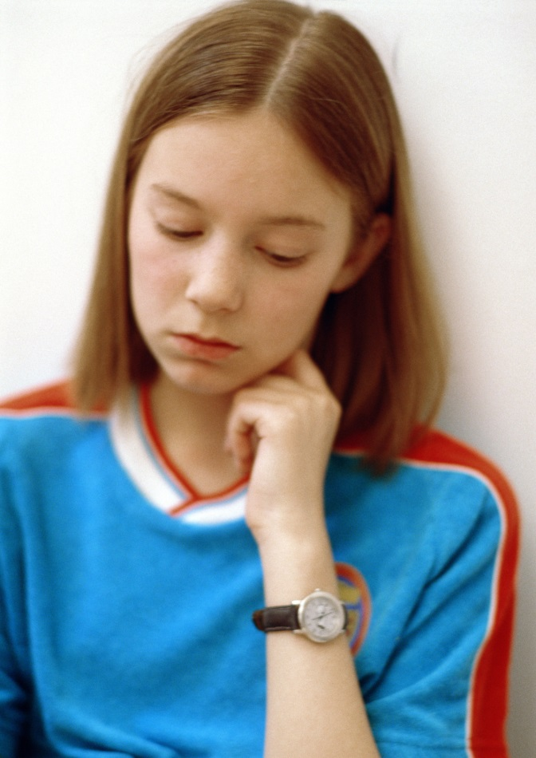
The Statistics
61% of people had children in their care when violence occurred, including 48% who said the children had seen and heard the violence
Children are present in 1 in 3 domestic and family violence matters reported to police in Australia
Boys who witness domestic and family violence are twice as likely to abuse their own partners and children when they become adults
It’s estimated only 14-36% of those subjected to domestic and family violence report it to police
Image courtesy of Department of State Development, Infrastructure and Planning³ © PhotoAlto
Notes:
Optional activity
Ask the group for ideas about why they think women and children don’t always report or seek help following experiences of violence or abuse?
Discuss why those affected by domestic and family violence don’t always report the abuse or violence.
Some answers include – shame/embarrassment, fear of escalating the violence or abuse, fear of not being believed, concerns for safety of children or other family members, lack of financial independence, a perception that their matter is too trivial to report, have previously been turned away when seeking support.
While it may appear a private issue, domestic and family violence, is a community issue– It affects the physical health and emotional wellbeing, the learning capacity and productivity and ability to earn a living for thousands of men, women and children across Queensland every day.
Australian Bureau of Statistics (ABS), 2012.
2, 3, 4. Family Violence piktograph published on Artsonline Monash University, Melbourne Tribune article entitled “$85 Million injected into family violence and ice research” 16 April 2015 Source: Crime Statistics Victoria, Domestic Violence Victoria, Australian Domestic and Family Violence Clearinghouse.
Image
Courtesy of Department of State Development, Infrastructure and Planning - Stock Images
Photographer/Source – Michael Bussy
Copyright - © PhotoAlto

Slide 7
Adults experiencing domestic and family violence may…
seem afraid of their partner or someone close to them
seem anxious, depressed, unusually quiet or less confident
have a controlling, obsessive or jealous partner
have a partner who has threatened them, their children or pets
have a depressed or suicidal partner
Notes:
A person may be in greater danger if:
There is a history of domestic and family violence
Violence, including sexual violence, has escalated within the relationship
Their partner is stalking or monitoring their movements
They separate or plan to separate from their partner without a safety plan in place
They start a new relationship or their ex-partner believes they have
There is conflict within the broader family
There are issues about child custody or access to children
They are pregnant
There is financial hardship or the partner becomes unemployed
The partner has a history of physical violence, mental illness or access to weapons.
Department of Communities, Child Safety and Disability Services Trust Your Instinct campaign https://www.communities.qld.gov.au/communityservices/violence-prevention/trust-your-instinct/domestic-and-family-violence/helping-others/signs-of-domestic-and-family-violence

Slide 8
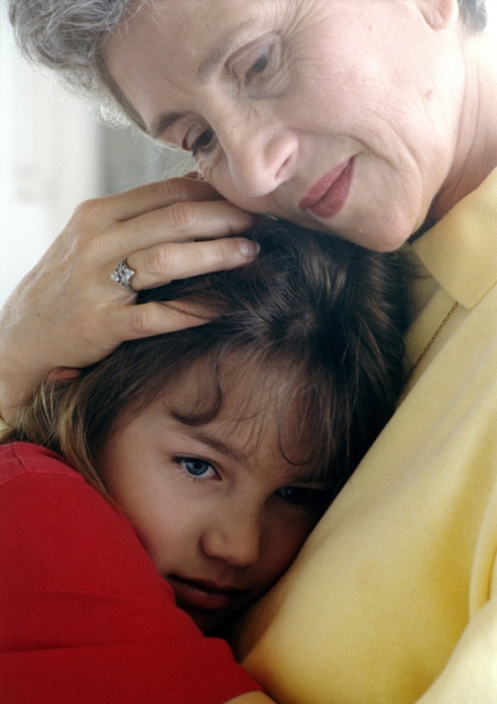
Adults experiencing domestic and family violence may…
stop contact with friends and family for no reason
know or suspect they are being stalked
receive constant texts or phone calls from their partner
appear neglected
be unable to access their money or belongings
© PhotoAlto. Photographer: Michael Bussy
Notes:
Image
PHOTOGRAPHER / SOURCE: Michael Bussy CAPTION / DESCRIPTION: © PhotoAlto. Photographer: Michael Bussy COPYRIGHT: © PhotoAlto

Slide 9
Children experiencing domestic and family violence may…
blame themselves for the violence
experience sleeping difficulties
regress to an earlier stage of development
become increasingly anxious or fearful
display aggressive or destructive behaviour
start to withdraw from people and events
Notes:
A child’s response to repeated domestic violence depends on a number of factors including their age, gender, personality and family role.
It is important to note that these signs may indicate other concerns for children, including the possibility of other forms of harm.
Sleep difficulties may include nightmares
Regression may include thumb sucking and bed wetting
Stress related illnesses may include headache or stomach pain
Speech difficulties may include stuttering
http://www.betterhealth.vic.gov.au/bhcv2/bhcpdf.nsf/ByPDF/Domestic_violence_and_children/$File/Domestic_violence_and_children.pdf

Slide 10
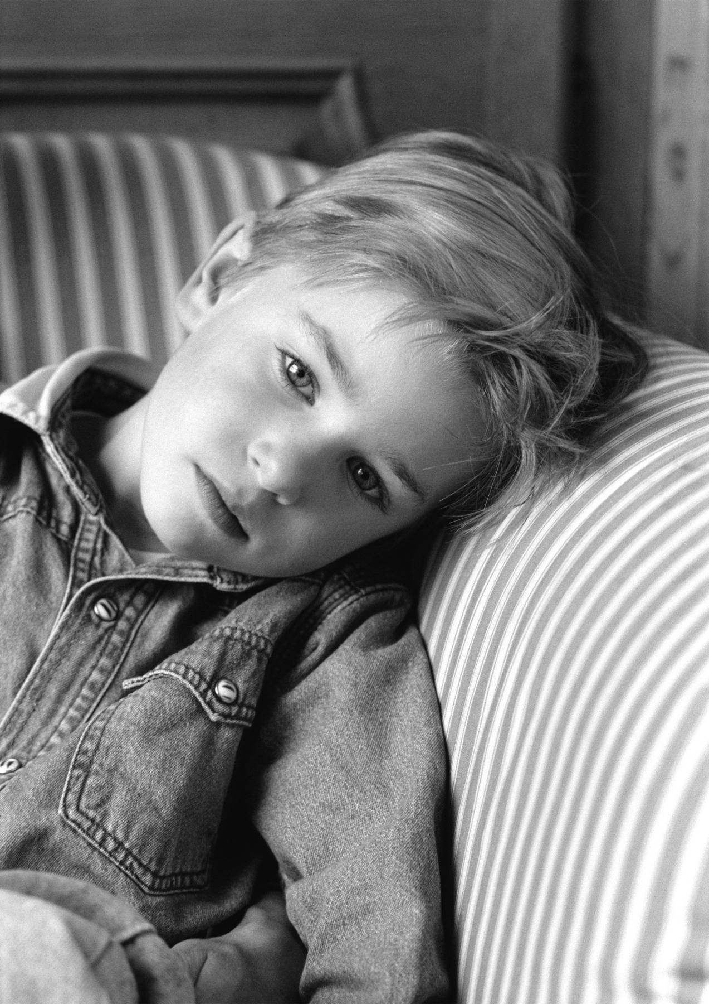
Children experiencing domestic and family violence may…
become a victim or perpetrator of bullying
start to show cruelty to animals
experience stress-related illnesses
display speech difficulties
misuse drugs and alcohol (young adults)
Image courtesy of Department of State Development, Infrastructure and Planning ⁴ © PhotoAlto
Notes:
http://www.betterhealth.vic.gov.au/bhcv2/bhcpdf.nsf/ByPDF/Domestic_violence_and_children/$File/Domestic_violence_and_children.pdf
Image
Courtesy of Department of State Development, Infrastructure and Planning - Stock Images
Photographer/Source – Michael Bussy
Copyright - © PhotoAlto

Slide 11
The Qld Government’s response to domestic and family violence
September 2014 - Taskforce on Domestic and Family Violence in Queensland, chaired by the Honourable Quentin Bryce AD CVO, former Governor-General of Australia, was established
February 2015 – Not Now, Not Ever: Putting an End to Domestic and Family Violence in Queensland Taskforce Report released
August 2015 - the Queensland Government accepted all 140 recommendations
August 2015 - draft Domestic and Family Violence Prevention Strategy released for consultation
The Department of Education and Training has leadership responsibility for 9 of the 140 recommendations
Notes:
10 September 2014 - Taskforce on Domestic and Family Violence in Queensland, chaired by the Honourable Quentin Bryce AD CVO, former Governor-General of Australia, was established
Feb 15 - Not Now, Not Ever: Putting an End to Domestic and Family Violence in Queensland’ Taskforce Report was handed to the Premier by Chair, Dame Quentin Bryce.
Aug 15 – 121 recommendations accepted as Government responsibility; the remaining 19 applied to the Non-Government sector and were fully supported by the Government.
Aug 15 – the draft Domestic and Family Violence Prevention Strategy was developed to provide a high level plan to eliminate domestic and family violence in Queensland over the next 10 years.
Leadership recommendations for DET include helping to change attitudes and behaviours of students towards violence and abuse in relationships, through curriculum and whole of school measures.

Slide 12

No More - DFV awareness raising at the US Super Bowl
Notes:
Explain that domestic and family violence is being tackled by governments and communities across the world. This is not just an issues of critical importance to Australians alone.
Watch the official Super Bowl NO MORE ad (the first-ever Super Bowl commercial addressing domestic violence and sexual assault). The ad aired live during the Super Bowl on February 1, 2015.
The 911 call is a re-enactment based on a true story, and inspired by other women using the tactic of disguising their calls while reaching out for help.
Double click on the video to make it play.

Slide 13
Support for staff affected by domestic and family violence may include
Special leave for emergent domestic and family violence issues
Workplace safety plans to help increase the safety of the affected staff member and others in the workplace
Flexible working conditions, if feasible – e.g. different start and finish times, altered work timetable
Support to return to work, if required
Temporary or permanent relocation
Access to confidential counselling
Notes:
Discretionary Paid Special Leave entitlements are outlined within the Special Leave Directive 9/13. Principals and Managers can approve up to 5 days. For discretionary special leave greater than 5 days, Regional Directors, Assistant Regional Directors and the Assistant Director General HR can consider and approve paid leave on a case by case basis. Documentation to support this leave request is desirable. If however documentation is not able to be provided to support the request, consideration and approval can be provided to all requests.
Workplace Safety Plan are similar to a Rehabilitation and Return to Work Plan
Have a start, review/end date and is developed by the Principal/Supervisor and affected staff member collaboratively.
Addresses issues such as:
identifying a safe place
identifying a co-worker
strategies for travelling to and from work
changes to working times
changes to work practices.

Slide 14

External support for staff affected by domestic and family violence
DV Connect offer the following services:
24/7 Womensline (PH: 1800 811 811)
Sexual Assault Helpline (PH: 1800 010 120) 7.30am - 11.30pm, 7 days
Mensline (PH: 1800 600 636) 9am - midnight, 7 days
Notes:
If you are concerned about a colleague, let them know your concerns privately and encourage them to speak to their Supervisor/Manager.
Encourage the person to contact a specialist domestic and family violence service for confidential information and support.

Slide 15
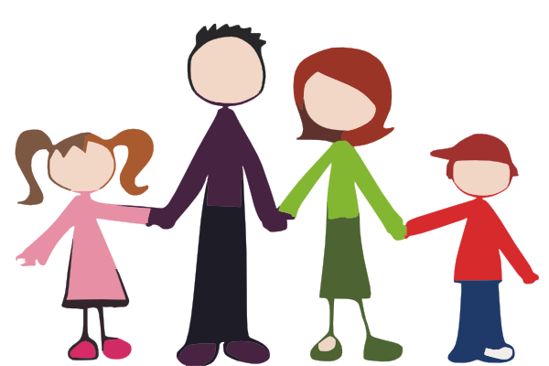
Curriculum resources
2016 Respectful relationships resources
P – 12
Delivered as part of a school’s student well-being or pastoral care program
Notes:
The recommendations relevant to schools, contained within the Not Now, Not Ever – Putting an End to Domestic and Family Violence in Queensland Taskforce Report include embedding within the existing curriculum:
information to assist children and young people to understand the importance of establishing and maintaining healthy, respectful relationships;
information about resolving conflict without violence and valuing gender equality; and
information helping students to recognise, respond and seek appropriate support when they or others feel unsafe.
In 2016 a new Respectful relationships resource will be released. It may be delivered as part of a school’s student well-being or pastoral care program.
The additional resource will be accessible to all state and non-state school teachers via a web-based platform.
Clipart attribution
http://www.clker.com/clipart-payslip.html

Slide 16
Curriculum resources
Curriculum into the Classroom (C2C) Health and Physical Education (HPE) units
P – 10
Content includes respectful relationships
Daniel Morcombe Child Safety Curriculum
P – 9
Topics of personal safety and awareness, including the prevention of abuse
Knowledge and skills to recognise, react to and report unsafe situations
Notes:
The C2C materials are available for all schools via OneSchool (state schools) or Scootle (non-state schools).
The Daniel Morcombe Child Safety Curriculum materials are also available through these platforms, and additionally through the Learning Place.

Slide 17

Support for students
Schools are able to provide direct support to students and families through the services of guidance officers or counsellors
Other school supports for students may include:
youth support coordinators
school-based youth health nurses
community liaison officers
chaplains
school-based police officers
As appropriate, principals and guidance officers are also able to refer families to appropriate external support services.
© Digital Vision¹
Notes:
Schools are able to support students and families through a variety of professionals and agencies including:
guidance officers
youth support coordinators
school-based youth health nurses
community liaison officers
chaplains
school-based police officers
Information about counselling and support for families experiencing domestic and family violence is available on the Queensland Government website at http://www.qld.gov.au/community/getting-support-health-social-issue/counselling-support-advice/index.html
Image
PHOTOGRAPHER / SOURCE: © Digital Vision.
DISTRIBUTION RESTRICTIONS: Please note this image is not 'sun safe'. There are 'sun safe' images available under the HEALTH/SUN SAFE topic is this is a requirement for your project.
COPYRIGHT: © Digital Vision.

Slide 18
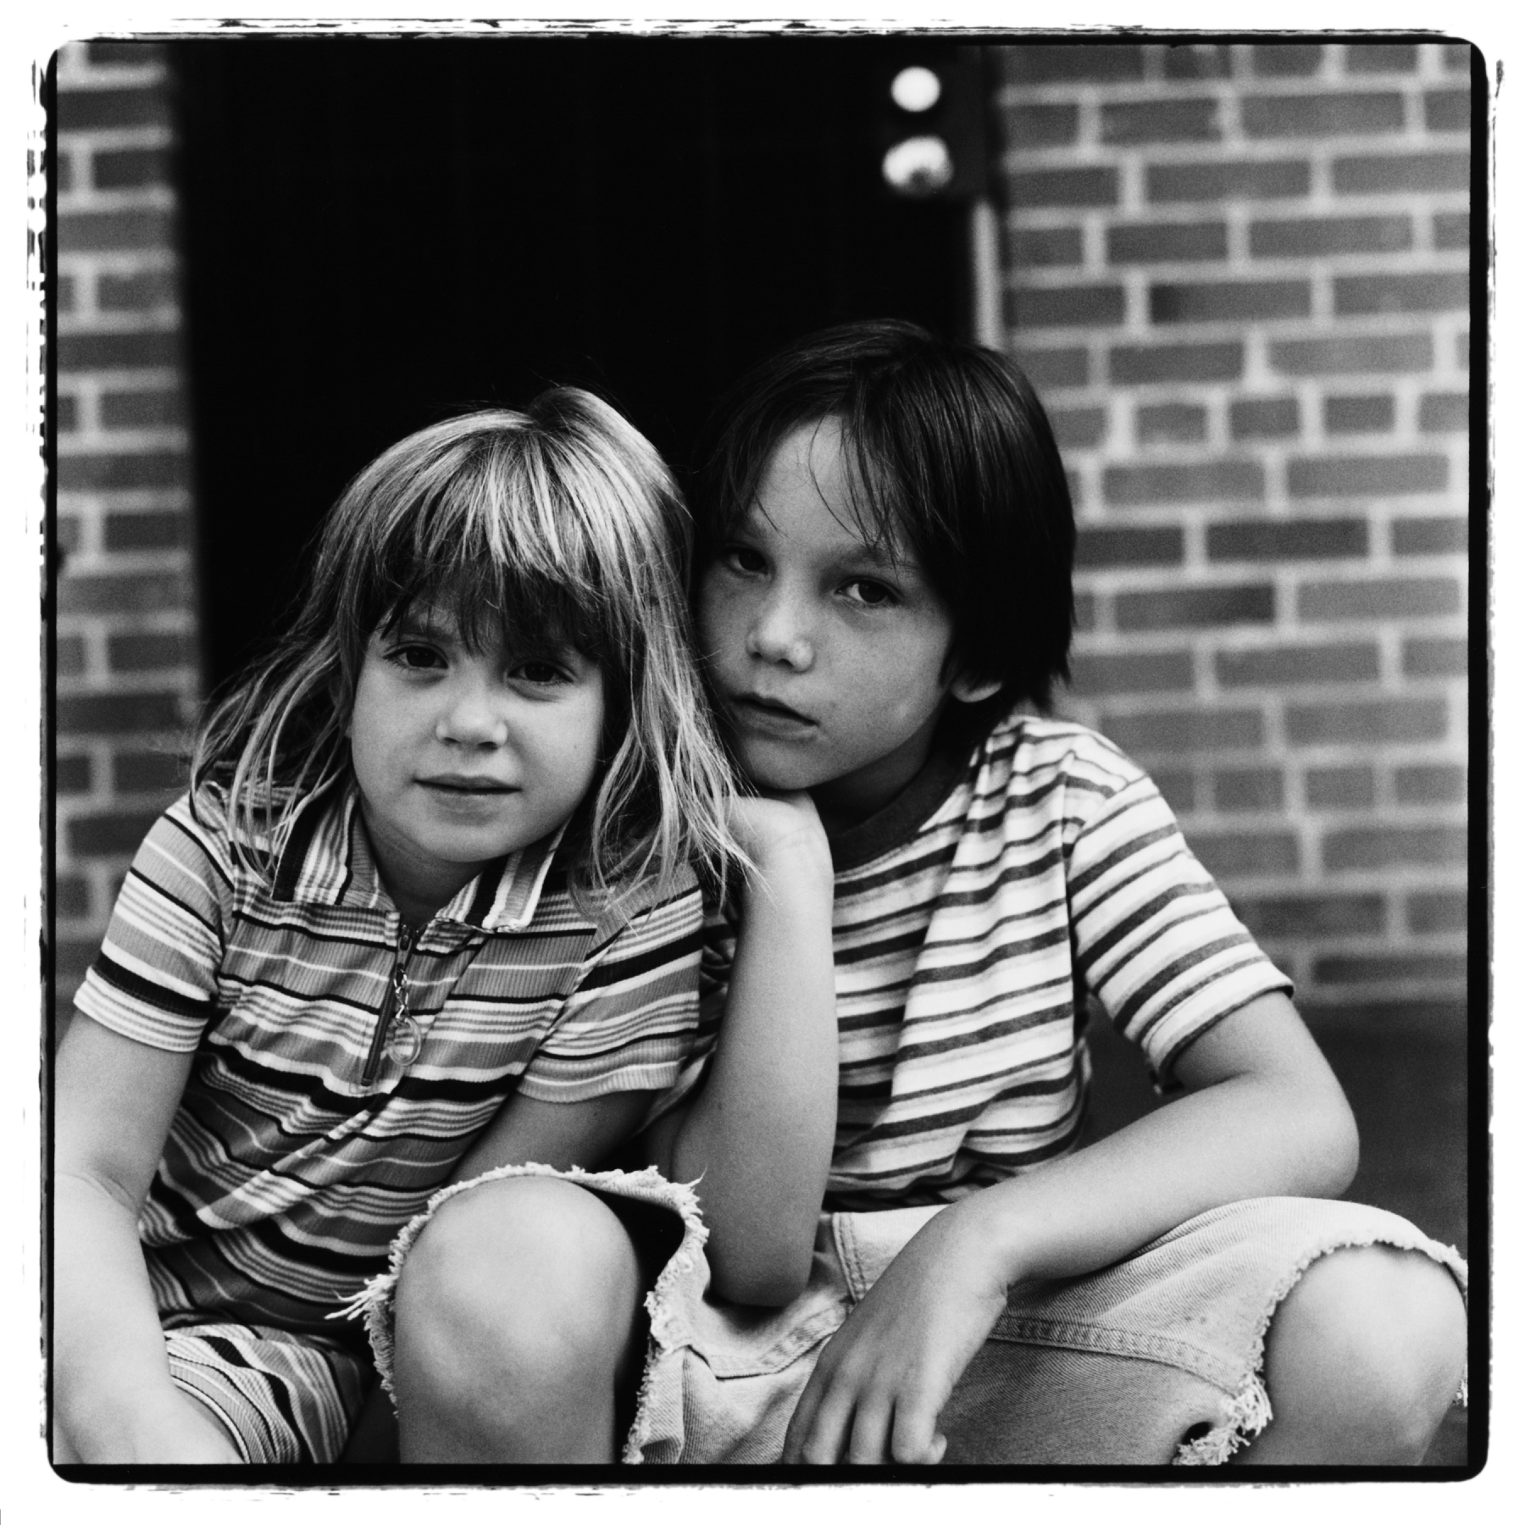
Reporting suspected harm
What are your responsibilities when you suspect a student has been harmed as a result of domestic and family violence?
All employees must respond when they suspect a student has been harmed or is at risk of harm as a result of abuse or neglect including physical or emotional abuse as a result of domestic and family violence
© Photodisc⁶
Notes:
Harm to a child, is any detrimental effect of a significant nature on the child’s physical, psychological or emotional wellbeing. Harm can be caused by:
sexual abuse or exploitation
physical abuse
psychological or emotional abuse
neglect
(Child Protection Act 1999)
Image
PHOTOGRAPHER OR SOURCE: Scott T. Baxter/Photodisc COPYRIGHT: © Photodisc.

Slide 19
Reporting suspected harm
Employees also have a responsibility to comply with mandatory reporting obligations under the Child Protection Act 1999.
Under s.13E teachers and registered nurses employed in a state schools must report when they reasonably and honestly suspect a child has suffered, is suffering or is at risk of suffering significant harm caused by physical or sexual abuse and may not have a parent able and willing to protect the child from harm.
Notes:
Harm may be considered ‘significant’ when it is sufficiently serious to warrant a response by a statutory agency, irrespective of a family's consent. Significant harm -
may reasonably be expected to produce a substantial and demonstrably adverse impact on the child’s safety, welfare, or well-being
is not minor or trivial
may be a single act or omission or an accumulation of acts or omissions.
(From the resource Queensland Child Protection Guide – an introduction for professionals published by the Children’s Research Centre)

Slide 20
The Student Protection reporting process
You suspect harm or risk of harm
Discuss your concerns with the Principal
Commence a Student Protection Report in OneSchool, when required
Submit the Report electronically to the Principal
Complete other actions after you Report eg supporting the student
Notes:
Further information on Student Protection Reporting processes and procedures are available on the OnePortal Student Protection webpage at https://oneportal.deta.qld.gov.au/Students/ChildSafetyWellbeing/studentprotection/Pages/Studentprotectiontraining.aspx including the Student Protection Procedure, Guidelines and training materials. You can also refer participants to the one page Student Protection Reporting process available from the Student Protection OnePortal site.
Talk the participants through each step of the process.

Slide 21
Questions

